Slide 1
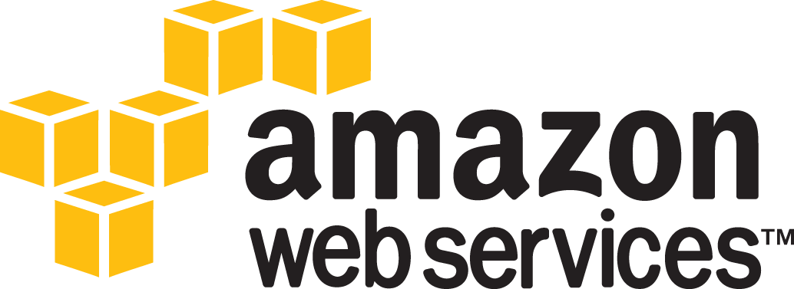
Notes:
DevOps is the practice of operations and development engineers participating together in the entire service lifecycle, from design through the development process to production support.

Slide 2





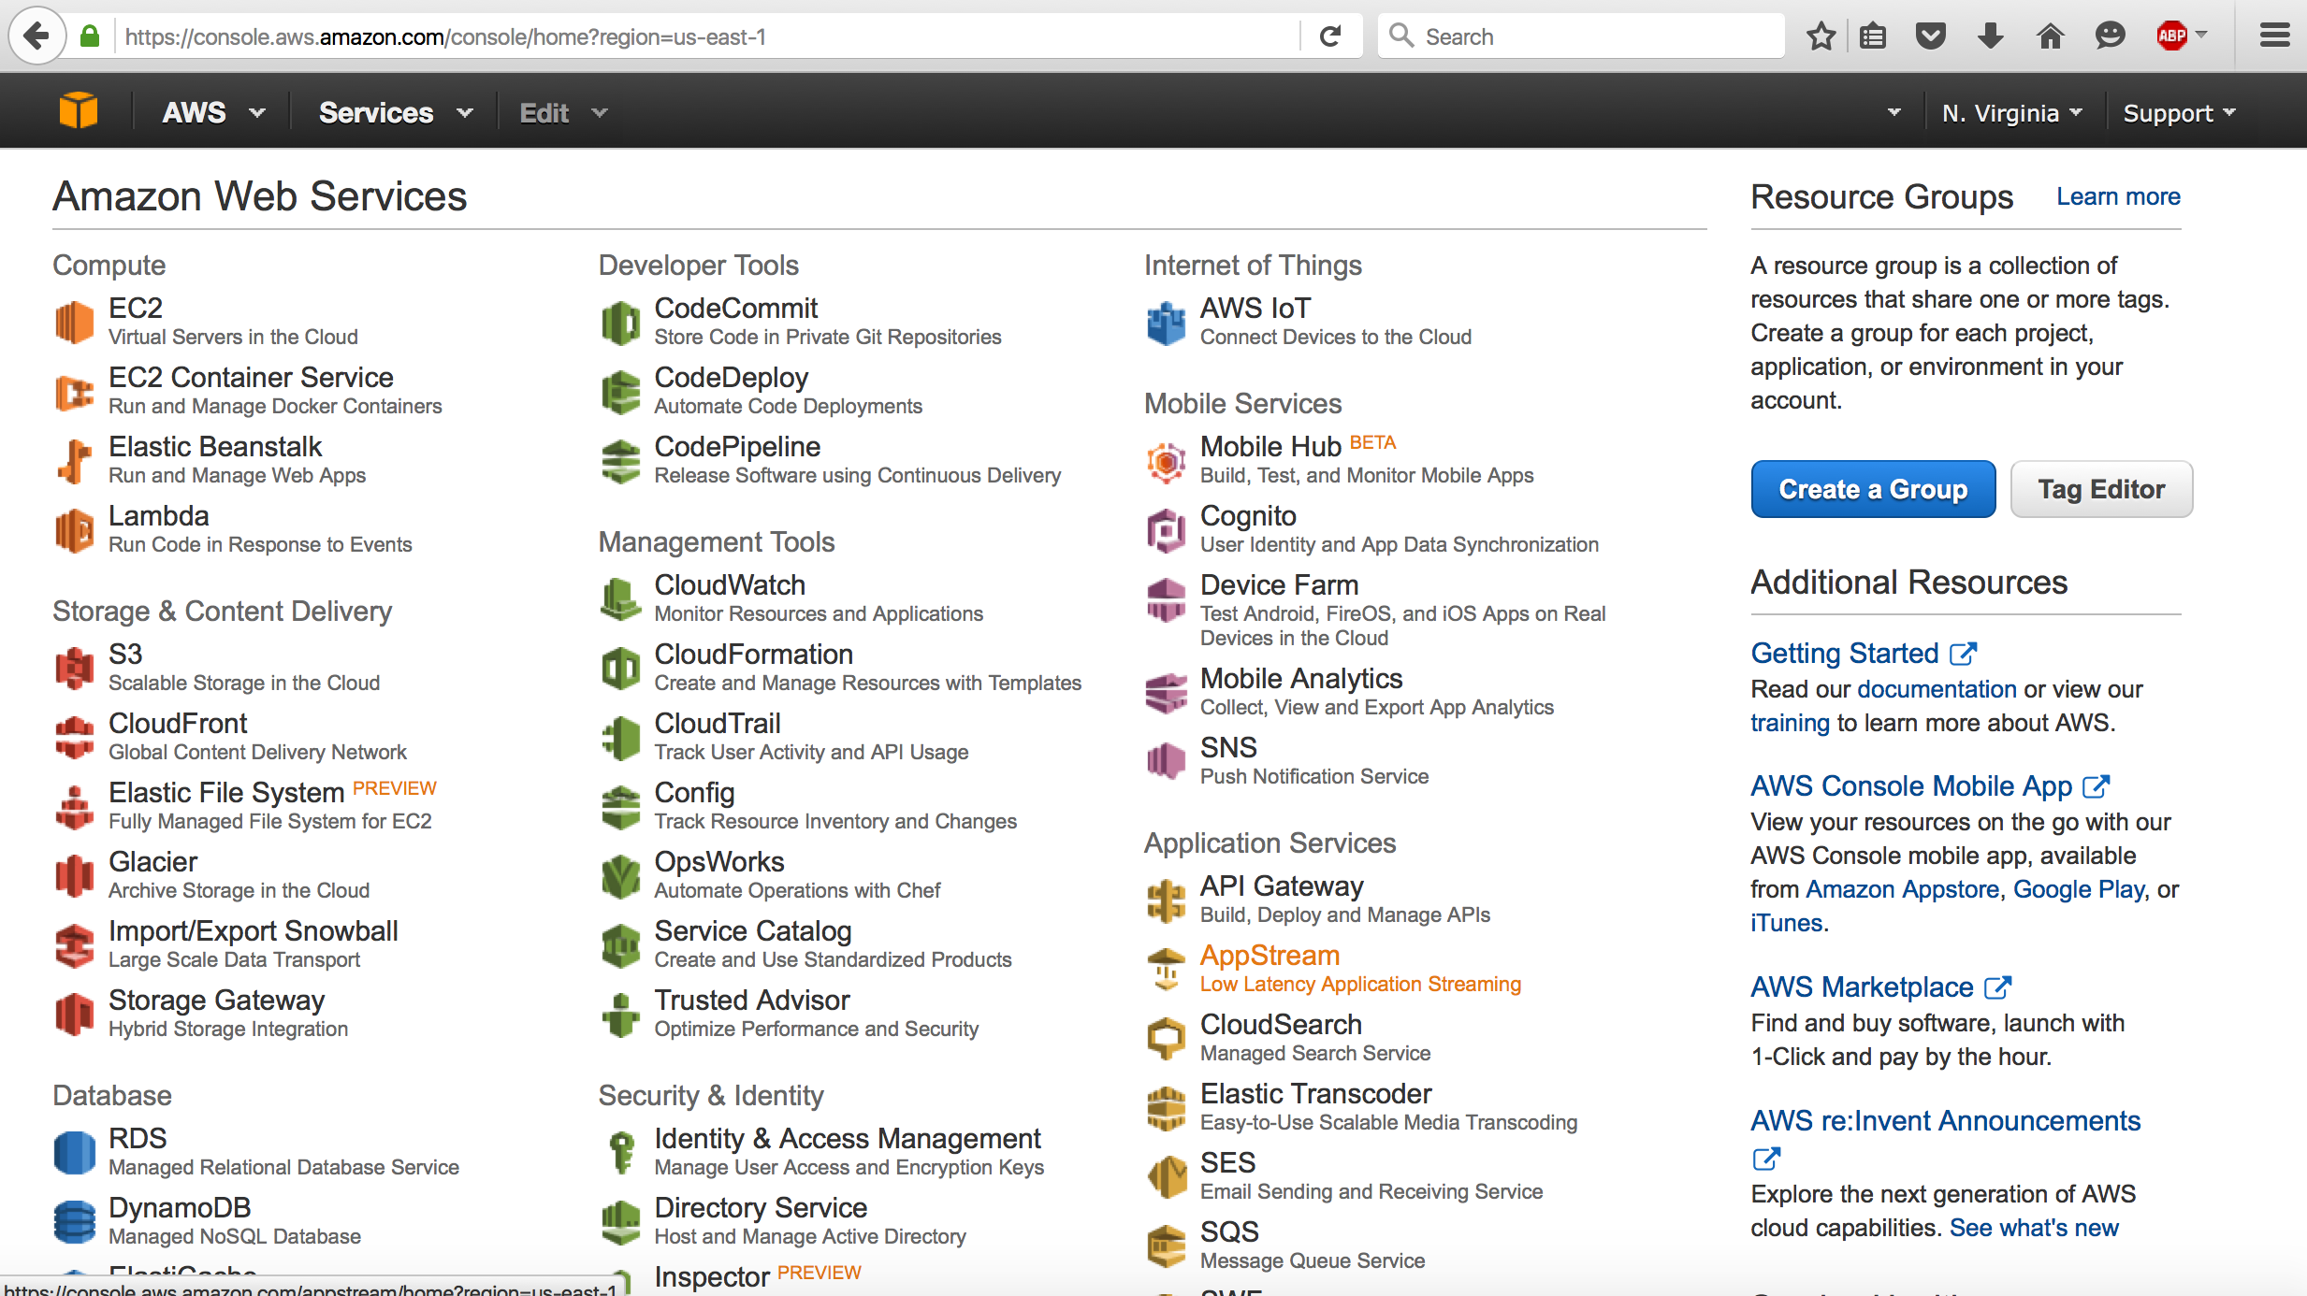

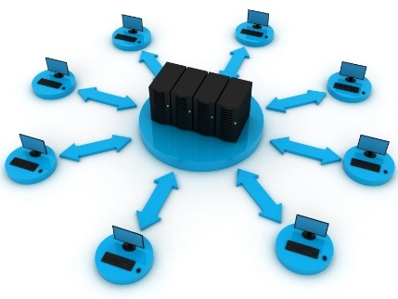
What is Cloud Computing?
Categories of Cloud Computing
Infrastructure as a Service (IaaS)
Platform as a Service (PaaS)
Software as a Service (SaaS)
Overview
refers to the on-demand delivery of IT resources and applications via the Internet with pay-as-you-go pricing.
Traditional
Infrastructure
as a Service
Platform
as a Service
Software
as a Service
Application
Application
Application
Application
provides a simple way to access servers, storage, databases and a broad set of application services over the Internet.
Application Architecture
Application Architecture
Application Architecture
Application Architecture
System Software
System Software
System Software
System Software
API
aws ec2 describe-instances
--output json
Database
Database
Database
Database
Operating System
Operating System
Operating System
Operating System
A combination of both Virtualization and Grid, but the end user does not have to care about the underlying architecture
Virtualization
Virtualization
Virtualization
Virtualization
Servers
Servers
Servers
Servers
Storage
Storage
Storage
Storage
Network
Network
Network
Network
Virtualization
One computer acting like many
Grid Computing
Many computers acting like one
Consumer Managed
Provider Managed
Notes:
Cloud Computing is a collection of computing services (compute, storage, network, applications, etc.) accessible on-demand over a network. It is a business and technology model for delivering and acquiring IT services in a utility-like fashion. Pay-as-you go pricing means that the resources can be commissioned or decommissioned anytime you want, you only pay for the exactly amount of time the resources has been used. Cloud computing is the on-demand delivery of compute power, database storage, applications, and other IT resources through a cloud services platform via the Internet with pay-as-you-go pricing. Whether you are running applications that share photos to millions of mobile users or you’re supporting the critical operations of your business, a cloud services platform provides rapid access to flexible and low-cost IT resources. With cloud computing, you don’t need to make large upfront investments in hardware and spend a lot of time on the heavy lifting of managing that hardware. Instead, you can provision exactly the right type and size of computing resources you need to power your newest bright idea or operate your IT department. You can access as many resources as you need, almost instantly, and only pay for what you use. Cloud computing provides a simple way to access servers, storage, databases and a broad set of application services over the Internet. A cloud services platform such as Amazon Web Services owns and maintains the network-connected hardware required for these application services, while you provision and use what you need via a web application.

Slide 3
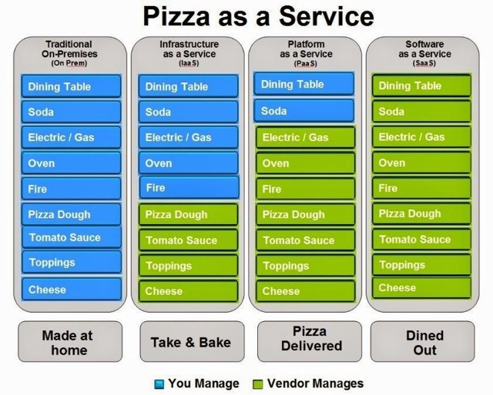
What is Cloud Computing?
Categories of Cloud Computing
Infrastructure as a Service (IaaS)
Platform as a Service (PaaS)
Software as a Service (SaaS)
Overview
refers to the on-demand delivery of IT resources and applications via the Internet with pay-as-you-go pricing.
provides a simple way to access servers, storage, databases and a broad set of application services over the Internet.
API
aws ec2 describe-instances
--output json
A combination of both Virtualization and Grid, but the end user does not have to care about the underlying architecture
Virtualization
One computer acting like many
Grid Computing
Many computers acting like one
Notes:
Infrastructure as a Service (IaaS)
Infrastructure as a Service (IaaS) contains the basic building blocks for cloud IT and typically provide access to networking features, computers (virtual or on dedicated hardware), and data storage space. IaaS provides you with the highest level of flexibility and management control over your IT resources and is most similar to existing IT resources that many IT departments and developers are familiar with today.
Platform as a Service (PaaS)
Platform as a Service (PaaS) removes the need for your organization to manage the underlying infrastructure (usually hardware and operating systems) and allows you to focus on the deployment and management of your applications. This helps you be more efficient as you don’t need to worry about resource procurement, capacity planning, software maintenance, patching, or any of the other undifferentiated heavy lifting involved in running your application.
Software as a Service (SaaS)
Software as a Service (SaaS) provides you with a completed product that is run and managed by the service provider. In most cases, people referring to Software as a Service are referring to end-user applications. With a SaaS offering you do not have to think about how the service is maintained or how the underlying infrastructure is managed; you only need to think about how you will use that particular piece of software. A common example of a SaaS application is web-based email which you can use to send and receive email without having to manage feature additions to the email product or maintain the servers and operating systems that the email program is running on.

Slide 4

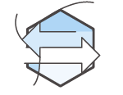




What is Cloud Computing?
Benefits
Stop spending money on running and maintaining data centers
Benefit from massive economies of scale
Trade capital expense for variable expense
Cloud Computing
Stop guessing capacity
Go global in minutes
Increase speed and agility
Notes:
Trade capital expense for variable expense
Instead of having to invest heavily in data centers and servers before you know how you’re going to use them, you can only pay when you consume computing resources, and only pay for how much you consume.
Benefit from massive economies of scale
By using cloud computing, you can achieve a lower variable cost than you can get on your own. Because usage from hundreds of thousands of customers are aggregated in the cloud, providers such as Amazon Web Services can achieve higher economies of scale which translates into lower pay as you go prices.
Stop guessing capacity
Eliminate guessing on your infrastructure capacity needs. When you make a capacity decision prior to deploying an application, you often either end up sitting on expensive idle resources or dealing with limited capacity. With Cloud Computing, these problems go away. You can access as much or as little as you need, and scale up and down as required with only a few minutes notice.
Increase speed and agility
In a cloud computing environment, new IT resources are only ever a click away, which means you reduce the time it takes to make those resources available to your developers from weeks to just minutes. This results in a dramatic increase in agility for the organization, since the cost and time it takes to experiment and develop is significantly lower.
Stop spending money on running and maintaining data centers
Focus on projects that differentiate your business, not the infrastructure. Cloud computing lets you focus on your own customers, rather than on the heavy lifting of racking, stacking and powering servers.
Go global in minutes
Easily deploy your application in multiple regions around the world with just a few clicks. This means you can provide a lower latency and better experience for your customers simply and at minimal cost.

Slide 5
What is Cloud Computing?
Elasticity
Infrastructure Cost
Customer dissatisfaction
Opportunity cost
Predicted demand
Scale-up approach
Actual demand
Automated Elasticity
Time

Slide 6
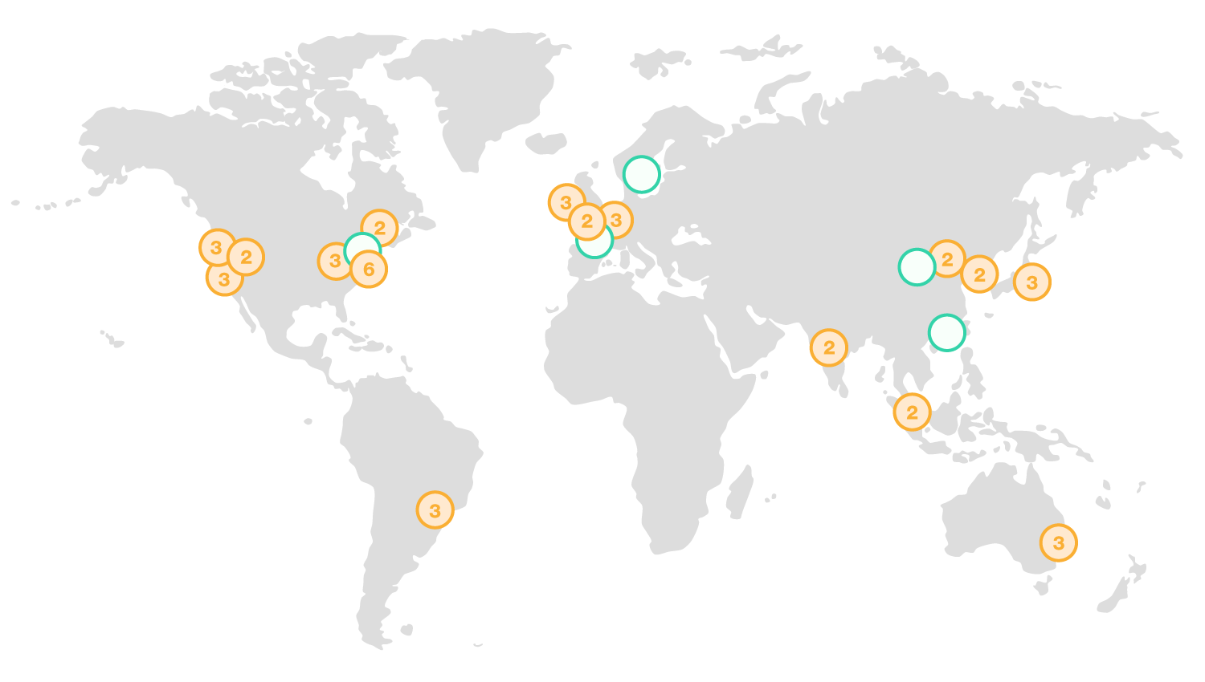


What is Amazon Web Services?
AWS Global Infrastructure
Overview
Provides computing resources and services that you can use to build applications within minutes.
has more than 70 services that span a wide range including compute, storage, networking, database, analytics, application services, deployment, management, mobile, developer tools and tools for the Internet of things.
Operates 44 Availability Zones within 16 geographic Regions around the world.
Amazon Web Services
Region & Number of Availability Zones
New Region
(coming soon)
China
France
Hong Kong
Sweden
AWS GovCloud
(US-East)
US East N. Virginia (6), Ohio (3)
Asia Pacific Mumbai (2), Seoul (2), Singapore (2), Sydney (3), Tokyo (3)
Canada Central (2)
Europe Frankfurt (3), Ireland (3), London (2)
Region
Availability Zone
Region
Availability Zone
China Beijing (2)
Availability Zone
Availability Zone
Availability Zone
Availability Zone
US West N. California (3), Oregon (3)
South America São Paulo (3)
AWS GovCloud
(US-West) (2)
Notes:
AWS serves over a million active customers in more than 190 countries. We are steadily expanding global infrastructure to help our customers achieve lower latency and higher throughput,4 and to ensure that their data resides only in the region they specify. As our customers grow their businesses, AWS will continue to provide infrastructure that meets their global requirements.
The AWS Cloud infrastructure is built around Regions and Availability Zones (AZs). A Region is a physical location in the world where we have multiple AZs. AZs consist of one or more discrete data centers, each with redundant power, networking, and connectivity, housed in separate facilities. These AZs offer you the ability to operate production applications and databases that are more highly available, fault tolerant, and scalable than would be possible from a single data center. The AWS Cloud operates 42 AZs within 16 geographic Regions around the world, with five more Availability Zones and two more Regions coming online in 2017.

Slide 7

What is Amazon Web Services?
Regions
eu-central-1 | EU (Frankfurt)
eu-west-2 | EU (London)
ap-northeast-1 | Asia Pacific (Tokyo)
ap-northeast-2 | Asia Pacific (Seoul)
ap-southeast-1 | Asia Pacific (Singapore)
ap-southeast-2 | Asia Pacific (Sydney)
ap-south-1 | Asia Pacific (Mumbai)
sa-east-1 | South America (São Paulo)
Overview
Code | Name
us-east-1 | US East (N. Virginia)
us-east-2 | US East (Ohio)
us-west-1 | US West (N. California)
us-west-2 | US West (Oregon)
ca-central-1 | Canada (Central)
eu-west-1 | EU (Ireland)
Provides computing resources and services that you can use to build applications within minutes.
has more than 70 services that span a wide range including compute, storage, networking, database, analytics, application services, deployment, management, mobile, developer tools and tools for the Internet of things.
Operates 44 Availability Zones within 16 geographic Regions around the world.
Availability Zones
us-west-1a
Amazon Web Services
us-west1c
Region
Availability Zone
Region
Availability Zone
us-west-1b
Availability Zone
Availability Zone
Availability Zone
Availability Zone
us-west-2a
us-west-2b
us-west-2c
Notes:
Each Amazon Region is designed to be completely isolated from the other Amazon Regions. This achieves the greatest possible fault tolerance and stability. Each AZ is isolated, but the AZs in a Region are connected through low-latency links. AWS provides you with the flexibility to place instances and store data within multiple geographic Regions as well as across multiple Availability Zones within each Region. Each Availability Zone is designed as an independent failure zone. This means that Availability Zones are physically separated within a typical metropolitan region and are located in lower risk flood plains (specific flood zone categorization varies by Region). In addition to discrete uninterruptable power supply (UPS) and onsite backup generation facilities, they are each fed via different grids from independent utilities to further reduce single points of failure. AZs are all redundantly connected to multiple tier-1 transit providers.

Slide 8
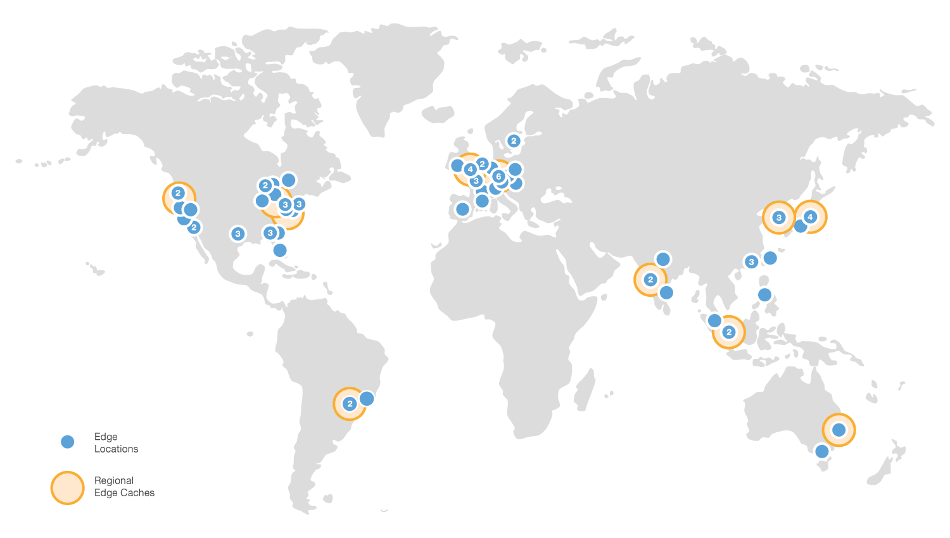
What is Amazon Web Services?
Overview
Provides computing resources and services that you can use to build applications within minutes.
has more than 70 services that span a wide range including compute, storage, networking, database, analytics, application services, deployment, management, mobile, developer tools and tools for the Internet of things.
Operates 44 Availability Zones within 16 geographic Regions around the world.
Amazon Web Services
Region
Availability Zone
Region
Availability Zone
Edge Locations
a global network of 82 edge locations and 11 regional edge caches across 23 countries and 49 cities for content delivery.
Availability Zone
Availability Zone
Availability Zone
Availability Zone

Slide 9
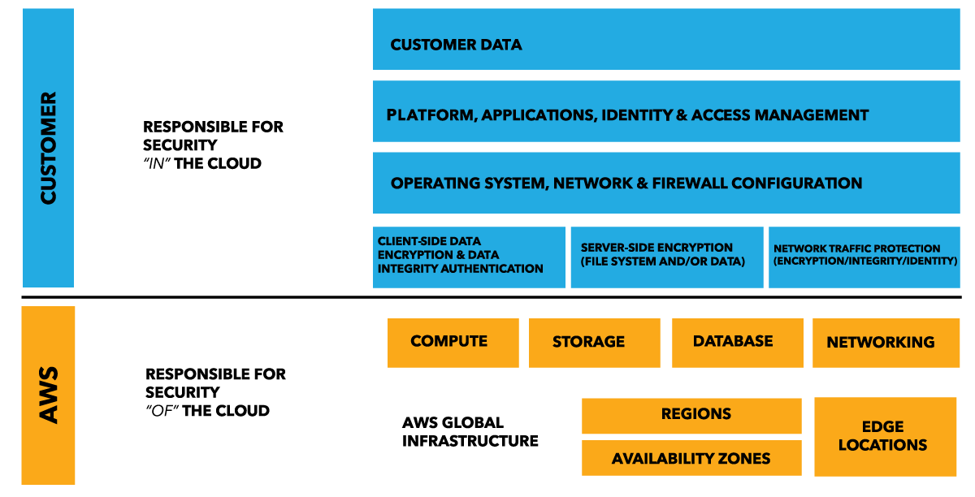
What is Amazon Web Services?
Security
Notes:
The AWS Cloud enables a shared responsibility model. While AWS manages security of the cloud, you are responsible for security in the cloud. This means that you retain control of the security you choose to implement to protect your own content, platform, applications, systems, and networks no differently than you would in an on-site data center.
AWS responsibility “Security of the Cloud” - AWS is responsible for protecting the infrastructure that runs all of the services offered in the AWS Cloud. this infrastructure is composed of the hardware, software, networking, and facilities that run AWS Cloud services.
Customer responsibility “Security in the Cloud” – Customer responsibility will be determined by the AWS Cloud services that a customer selects. This determines the amount of configuration work the customer must perform as part of their security responsibilities. For example, services such as Amazon Elastic Compute Cloud (Amazon EC2), Amazon Virtual Private Cloud (Amazon VPC), and Amazon S3 are categorized as Infrastructure as a Service (IaaS) and, as such, require the customer to perform all of the necessary security configuration and management tasks. If a customer deploys an Amazon EC2 instance, they are responsible for management of the guest operating system (including updates and security patches), any application software or utilities installed by the customer on the instances, and the configuration of the AWS-provided firewall (called a security group) on each instance.

Slide 10
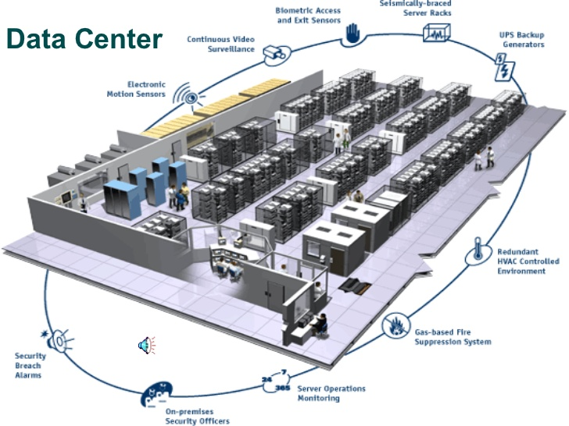
What is Amazon Web Services?
Security - AWS
AWS Security Whitepaper: https://d0.awsstatic.com/whitepapers/Security/AWS_Security_Best_Practices.pdf
Notes:
Cloud security at AWS is the highest priority. As an AWS customer, you will benefit from a data center and network architecture built to meet the requirements of the most securitysensitive organizations. Security in the cloud is much like security in your on-premises data centers—only without the costs of maintaining facilities and hardware. In the cloud, you don’t have to manage physical servers or storage devices. Instead, you use software-based security tools to monitor and protect the flow of information into and of out of your cloud resources.
Benefits of AWS Security
• Keep Your Data Safe: The AWS infrastructure puts strong safeguards in place to help protect your privacy. All data is stored in highly secure AWS data centers.
• Meet Compliance Requirements: AWS manages dozens of compliance programs in its infrastructure. This means that segments of your compliance have already been completed. Amazon Web Services – Overview of Amazon Web Services Page 6
• Save Money: Cut costs by using AWS data centers. Maintain the highest standard of security without having to manage your own facility
• Scale Quickly: Security scales with your AWS Cloud usage. No matter the size of your business, the AWS infrastructure is designed to keep your data safe.

Slide 11
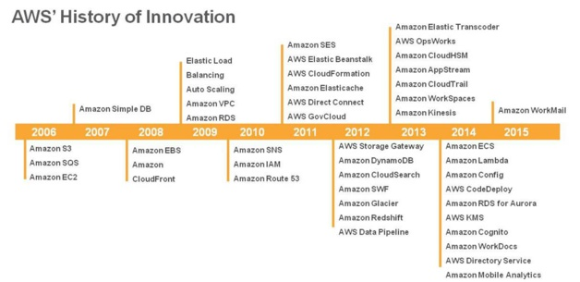
What is Amazon Web Services?
Overview

Slide 12




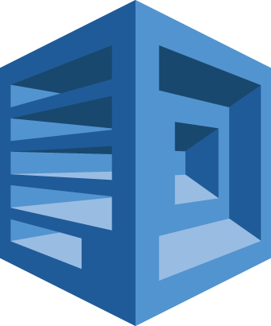



























































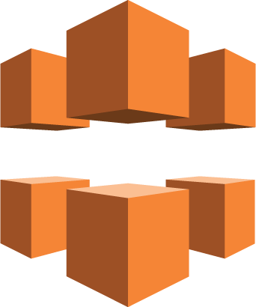



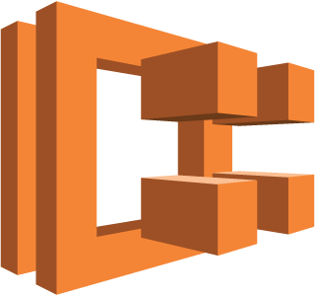





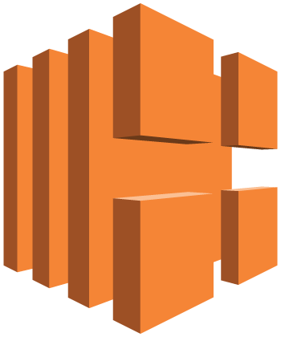

Gaming
Business Productivity
Artificial Inteligence
Internet of Things
Messaging
Streaming
Amazon
GameLift
Amazon WorkDocs
Amazon WorkMail
Amazon Lex
Amazon Polly
Amazon Rekognition
Amazon Machine Learning
AWS IoT
AWS
Greengrass
Amazon
SES
Amazon SNS
Amazon SQS
Amazon AppStream 2.0
Amazon WorkSpaces
Application Services
Developer Tools
Mobile Services
AWS
Step Functions
Amazon
SWF
Amazon API Gateway
Amazon Elastic Transcoder
AWS CodeCommit
AWS CodeBuild
AWS CodeDeploy
AWS CodePipeline
AWS X-Ray
AWS Mobile Hub
Amazon Cognito
AWS Device Farm
Amazon Mobile Analytics
Amazon
Pinpoint
Analytics
Security & Identity
Management Tools
AWS Infrastructure Platform, Products and Services
Amazon Athena
Amazon EMR
Amazon CloudSearch
Amazon ES
IAM
Amazon Inspector
AWS Certificate Manager
AWS Directory Service
Amazon CloudWatch
AWS CloudFormation
AWS CloudTrail
AWS Config
Amazon Kinesis
AWS Data Pipeline
Amazon QuickSight
AWS WAF
AWS Shield
AWS Artifact
AWS CloudHSM
AWS OpsWorks
AWS Service Catalog
AWS Trusted Advisor
AWS Managed Services
Migration
Storage
Database
AWS Application Discovery Service
AWS DMS
AWS SMS
AWS Snowball
Amazon S3
Amazon EFS
Amazon Glacier
AWS Storage Gateway
Amazon DynamoDB
Amazon ElastiCache
Amazon RDS
Amazon Redshift
Network Content Delivery
Compute
Amazon VPC
Amazon CloudFront
AWS Direct Connect
Amazon Route 53
Amazon
EC2
Amazon
ECS
Amazon
ECR
Amazon
Lightsail
AWS Elastic Beanstalk
AWS
Lambda
AWS Batch
Elastic Load Balancing
Auto Scaling

Slide 13

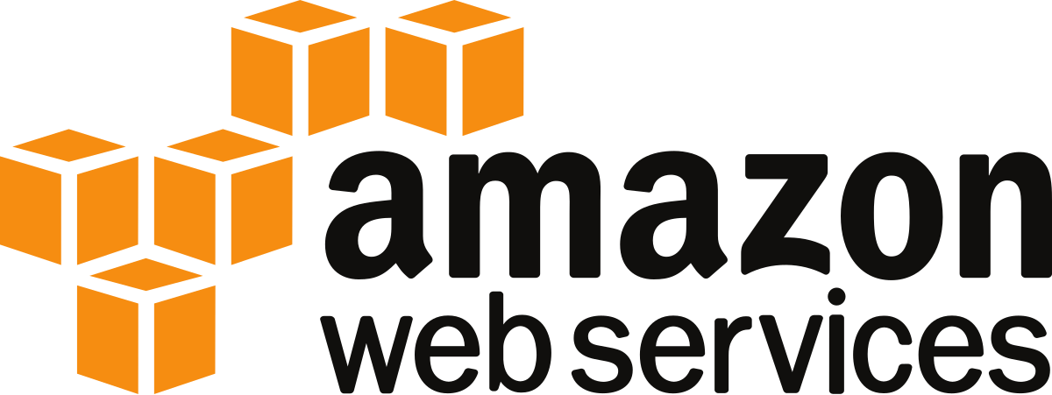






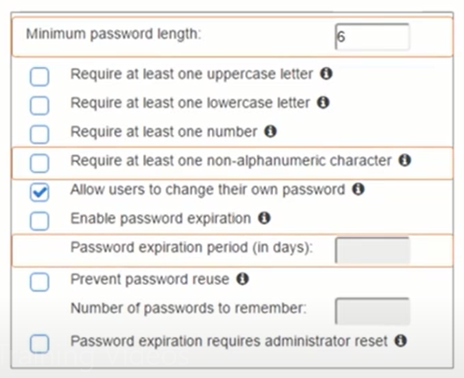
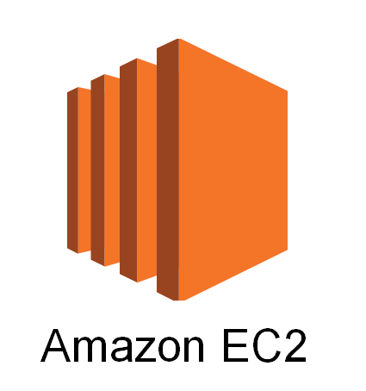
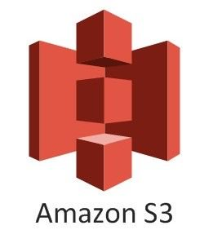



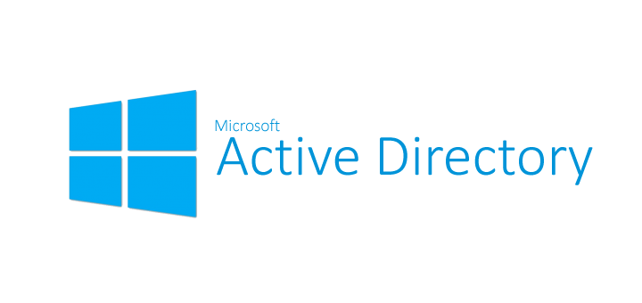
Identity and Access Management
Shared Access
Multi-Factor Authentication
Overview
Root User /
Admin User
Role
User
User ID and Password
Policy
Developers
Database Admins
MFA Devices Code
125112
Group
Enables you to securely control user access to all AWS services and resources.
Provides shared access and granular permissions using policies.
Provides multi-factor authentication and identity federation
Granular Permissions
Password Policy
EC2 Full Access Policy
S3 Full Access Policy
RDS Full Access Policy
Game Development
Artificial Intelligence
Messaging
Business Productivity
Internet of Things
Desktop & App Streaming
Application Services
Developer Tools
Mobile Services
Identity Federation
Analytics
Security & Identity
Management Tools
Migration
Storage
Databases
Networking & Content Delivery
Compute
AWS Global Infrastructure

Slide 14
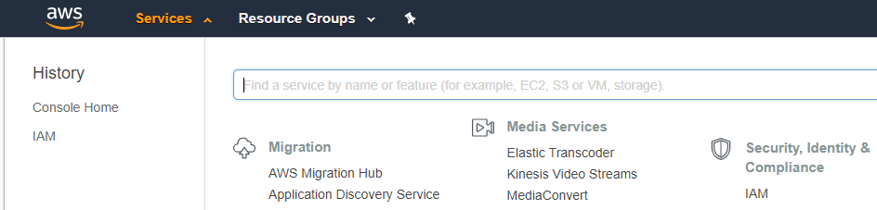
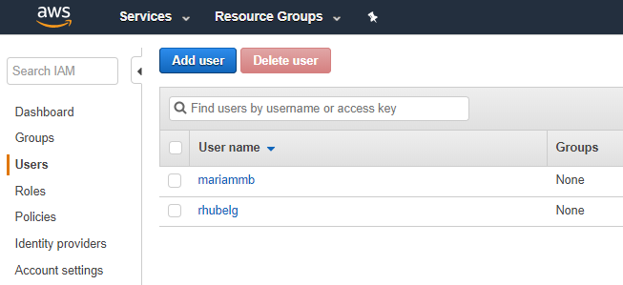
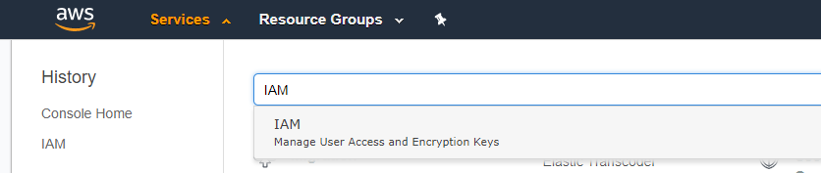
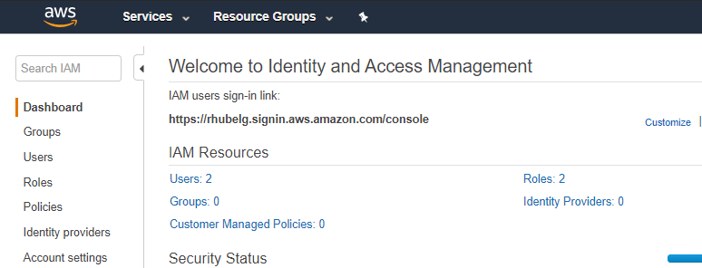
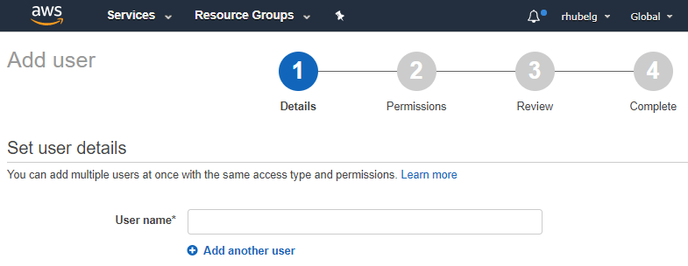
Identity and Access Management
Creating a User
Click Services and choose IAM under Security, Identity & Compliance
On the IAM dashboard, Click Users and Click Add User
Or type the ‘IAM’ on the textbox
After clicking, the IAM dashboard is shown
Follow the steps in adding a User

Slide 15
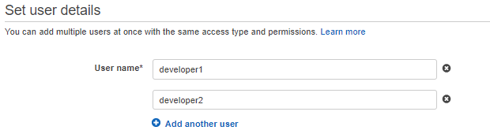
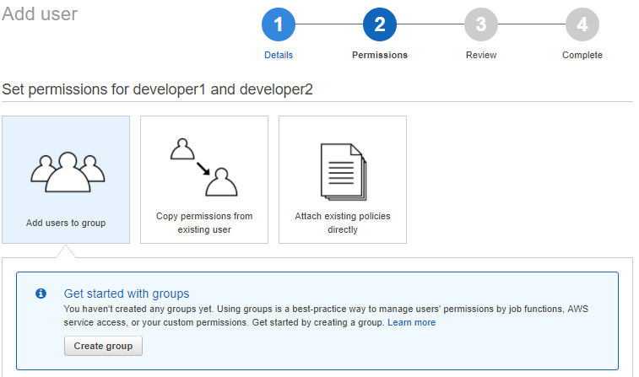
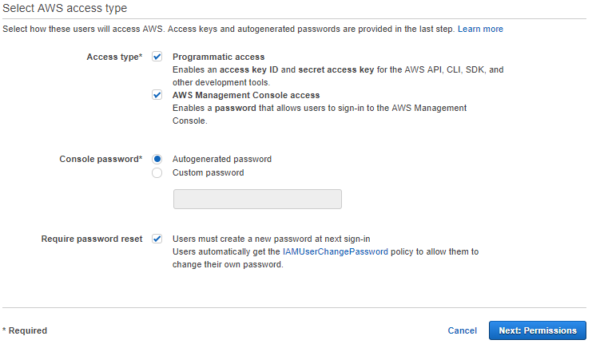
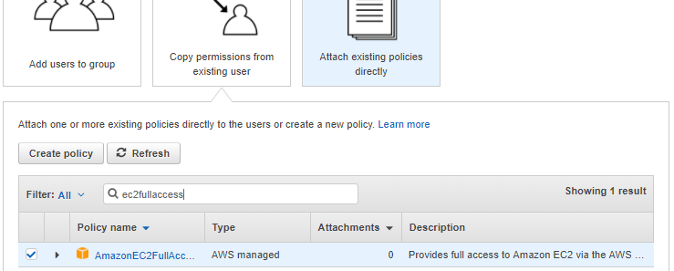
Identity and Access Management
Creating a User
On the Permissions Step, you can add the users to a group, copy permissions from existing user or attach the policies directly
Input the desired usernames of the users on the textbox
Add a programmatic access when the user requires an access to the API, CLI, SDK and other development tools and add a AWS Management Console access to access the web UI
When attaching the existing policies directly, search for the appropriate policy

Slide 16
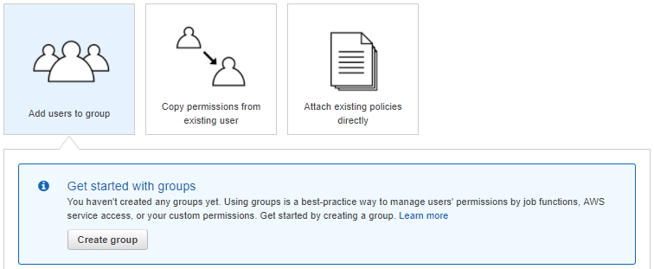
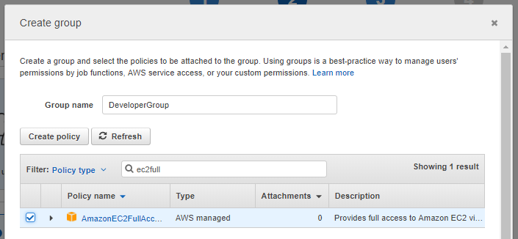
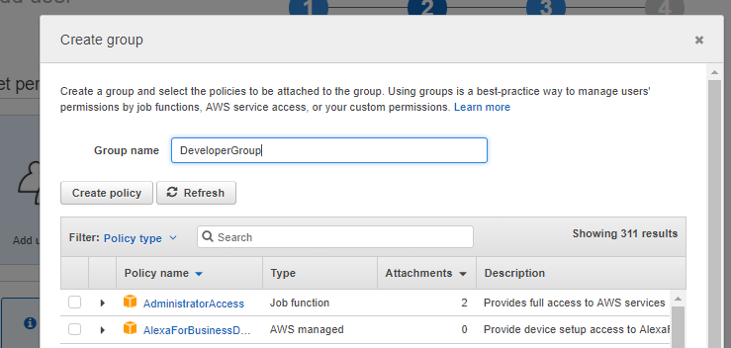
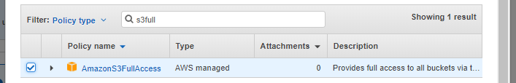
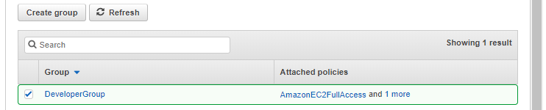
Identity and Access Management
Creating a Group
When adding the users to a group, click Create Group
Search for the policies that will be attached to the group and click the checkbox beside it
After clicking Create Group, a popup will appear. Specify a Group name.
You can add multiple policies and attach it to the group
After clicking Create Group, the group is automatically selected and contain the policies

Slide 17
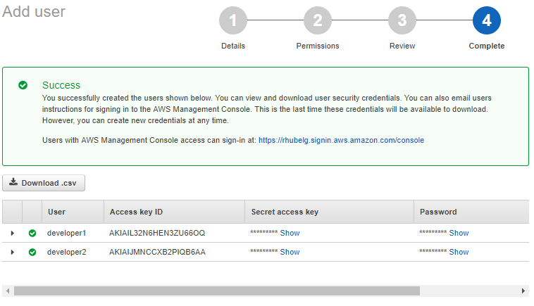
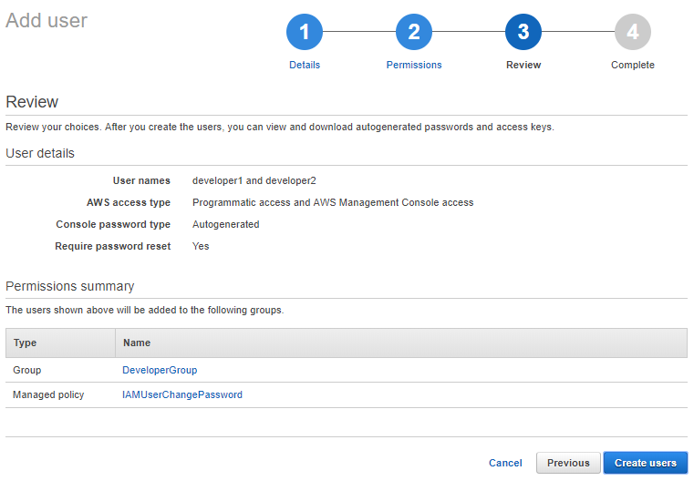
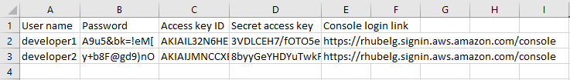
Identity and Access Management
Creating a User
On the third step ‘Review’, you can view the choices that you’ve made earlier including the usernames and their access types, the group that they belong to and the policies attached to them. After reviewing, click Create users
On the last step, you can view the passwords of the created users and their access key id and secret access keys.
To download the credentials to an external file, click the Download.csv.

Slide 18
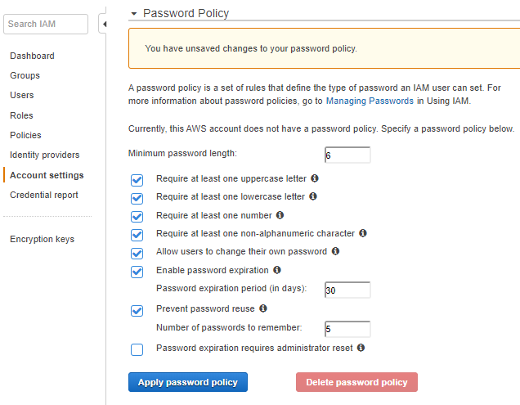
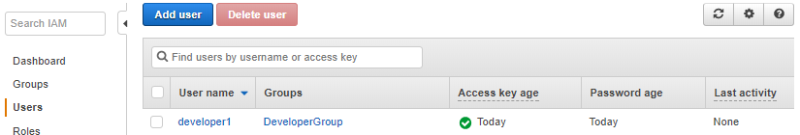
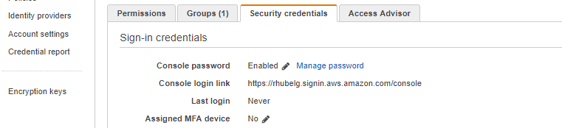
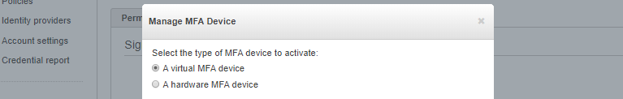
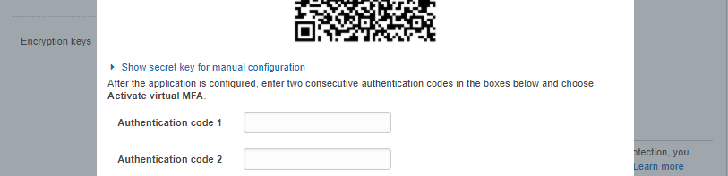
Identity and Access Management
Other Features
To change the password policy, click Account Settings on the IAM dashboard
To enable the Multi-factor authentication to a user. Click on the desired user.
Under security credentials, click the pen beside the Assigned MFA device
Choose ‘a virtual MFA device’ and download third-party app like Google Authenticator
Scan the QR code and input two consecutive authentication codes.

Slide 19


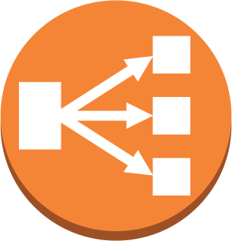






High Availability Architecture
Overview
US Users
Amazon Route 53
EU Users
Elastic Load Balancer
Elastic Load Balancer
Availability Zone A
Availability Zone B
Availability Zone A
Availability Zone B
Amazon CloudFront
EC2 Instances
Auto Scaling
EC2 Instances
EC2 Instances
Auto Scaling
EC2 Instances
Public Subnet
Public Subnet
Public Subnet
Public Subnet
Amazon ElastiCache
Amazon ElastiCache
S3 Bucket
Amazon ElastiCache
Amazon ElastiCache
Data Sync between Regions
RDS DB instance read replica
RDS DB instance
RDS DB instance
standby
RDS DB instance read replica
RDS DB instance read replica
RDS DB instance
RDS DB instance
standby
RDS DB instance read replica
Private Subnet
Private Subnet
Private Subnet
Private Subnet

Slide 20

High Availability Architecture
Scaling to >1 Users
Users
Vertical Scaling
xlarge
large
Amazon Route 53
micro
Availability Zone A
EC2 Instance
Public Subnet

Slide 21
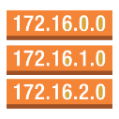







Virtual Private Cloud (VPC)
Amazon Web Services
Overview
Virtual Private Cloud ( 192.168.0.0/16)
Internet Gateway
Enables you to provision a logically isolated section of the cloud.
Complete control over your virtual networking environment, including selection of your own IP address range, creation of subnets, and configuration of route tables and network gateways.
Enables you to create a Hardware Virtual Private Network (VPN) connection between your corporate datacenter and your VPC and leverage the AWS Cloud as an extension of your corporate datacenter.
Public Subnet (192.168.1.0/24)
Security Group
Network ACL
EC2 Instance
Public Route Default
Users
Virtual Private Cloud (10.0.0.0 /16)
Internet Gateway
Public Subnet (10.0.1.0 /24)
Security Group
Network ACL
EC2 Instance
Public Route Default
Private Subnet (10.0.2.0 /24)
corporate data center
Security Group
Network ACL
Game Development
Artificial Intelligence
Messaging
Virtual Private Gateway
Business Productivity
Internet of Things
Desktop & App Streaming
EC2 Instance
Private Route Default
Application Services
Developer Tools
Mobile Services
VPC Peering
Analytics
Security & Identity
Management Tools
Amazon Web Services
Migration
Storage
Databases
Virtual Private Cloud (10.0.0.0 /16)
Networking & Content Delivery
Compute
Public Subnet (10.0.0.0 /24)
AWS Global Infrastructure

Slide 22
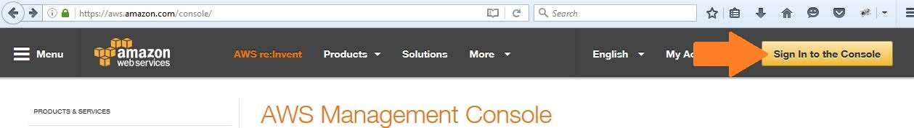
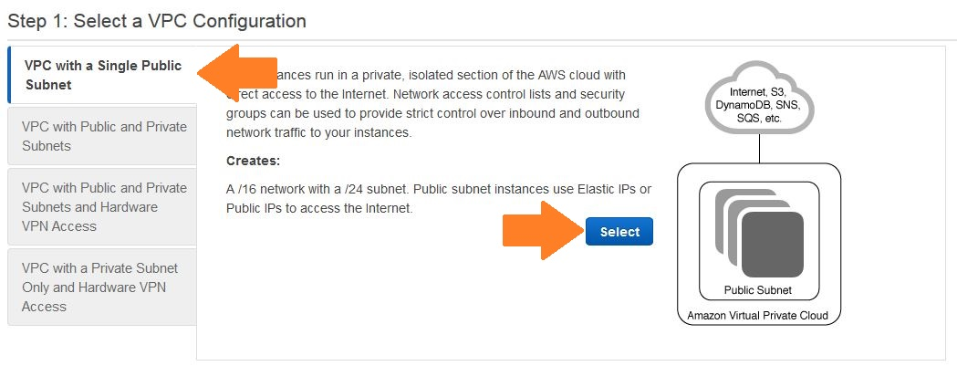
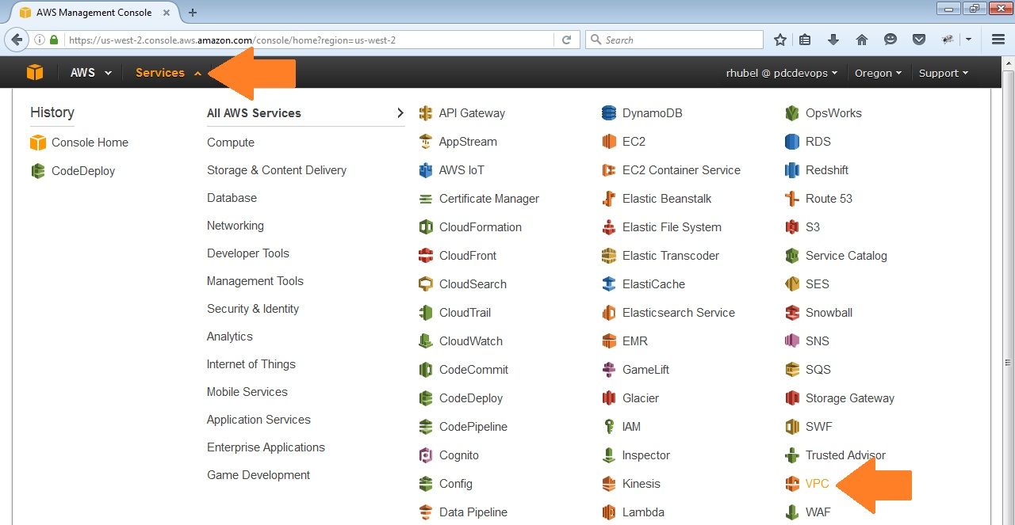
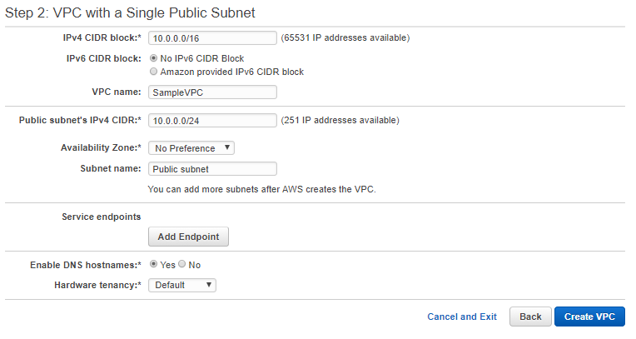
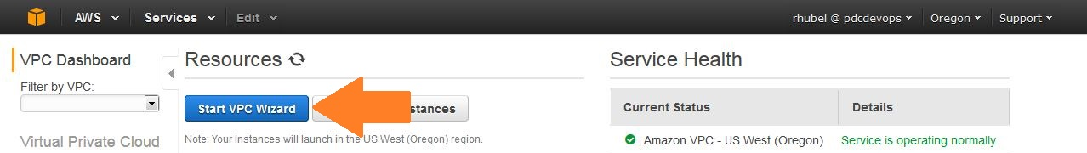
Virtual Private Cloud (VPC)
Creating a VPC
Navigate to https://aws.amazon.com/console . Click ‘Sign In to the Console’ and Login.
Select ‘VPC with a Single Public Subnet’ as a VPC Configuration. Click Select.
Click ‘Services’ and choose ‘VPC’
Type a VPC name and Click Create VPC.
Click ‘Start VPC Wizard’.
Notes:
Region & Number of Availability Zones
US East N. Virginia (6), Ohio (3)
US West N. California (3), Oregon (3)
Asia Pacific Mumbai (2), Seoul (2), Singapore (2), Sydney (3), Tokyo (3)
Canada Central (2)
China Beijing (2)
Europe Frankfurt (3), Ireland (3), London (2)
South America São Paulo (3)
AWS GovCloud (US-West) (2)
New Region (coming soon)
China
France
Hong Kong
Sweden
AWS GovCloud (US-East)

Slide 23
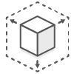
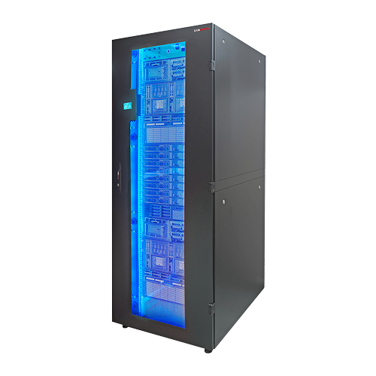







Elastic Compute Cloud (EC2)
Benefits
Instance Types
Instance generation
Overview
Instance family
t2.large
Instance size
Elastic Web-Scale
Computing
Family | Specialty | Use case
D2 | Dense Storage | Fileservers/Data Warehouse
R4 | Memory Optimized | Memory Intensive Apps/DBs
M4 | General Purpose | Application Servers
C4 | Compute Optimized | CPU Intensive Apps/DBs
G2 | Graphics Intensive | Video Encoding
I2 | High Speed Storage | NoSQL DB, Data Warehouse
F1 | Field Programmable Gate Array | Hardware Acceleration
T2 | Lowest Cost, General Purpose | Webserver/Small DBs
P2 | Graphics/ General Purpose | Machine Learning / Bit coin mining
X1 | Memory Optimized | SAP Hana / Apache Spark
Guest1
Guest2
Guest3
EC2 Instance
EC2 Instance
EC2 Instance
Completely Controlled
Flexible Cloud Hosting Services
Hypervisor
Integrated
Host Server
Reliable
Secure
Elastic Virtual servers in the cloud
Provides resizable compute capacity
Servers from $0.02 per hour
On-Demand, Reserved, and Spot Pricing
Supports Windows, Linux, CentOS, RedHat
Inexpensive
Options
Game Development
Artificial Intelligence
Messaging
On-Demand Instances
Reserved Instances
Spot Instances
Business Productivity
Internet of Things
Desktop & App Streaming
Pay for compute capacity by the hour with no long-term commitments
For spiky workloads, or to define needs
Make an EC2 usage commitment and receive a significant discount
For committed utilization
Bid for unused capacity, charged at a Spot price which fluctuates based on supply and demand
For time-insensitive or transient workloads
Application Services
Developer Tools
Mobile Services
Analytics
Security & Identity
Management Tools
Migration
Storage
Databases
Networking & Content Delivery
Compute
AWS Global Infrastructure
Notes:
Benefits
Elastic Web-Scale Computing
Amazon EC2 enables you to increase or decrease capacity within minutes, not hours or days.
You can commission one, hundreds, or even thousands of server instances simultaneously.
Because this is all controlled with web service APIs, your application can automatically scale
itself up and down depending on its needs.
Completely Controlled
You have complete control of your Amazon EC2 instances. You have root access to each one,
and you can interact with them as you would any machine. You can stop your Amazon EC2
instance while retaining the data on your boot partition, and then subsequently restart the
same instance using web service APIs. Instances can be rebooted remotely using web service
APIs.
Flexible Cloud Hosting Services
You can choose among multiple instance types, operating systems, and software packages.
Amazon EC2 allows you to select the memory configuration, CPU, instance storage, and boot
partition size that are optimal for your choice of operating system and application. For
example, your choice of operating systems includes numerous Linux distributions and
Microsoft Windows Server.
Integrated
Amazon EC2 is integrated with most AWS services, such as Amazon Simple Storage Service
(Amazon S3), Amazon Relational Database Service (Amazon RDS), and Amazon Virtual Private
Cloud (Amazon VPC) to provide a complete, secure solution for computing, query processing,
and cloud storage across a wide range of applications.
Reliable
Amazon EC2 offers a highly reliable environment where replacement instances can be rapidly
and predictably commissioned. The service runs within Amazon’s proven network
infrastructure and data centers. The Amazon EC2 Service Level Agreement (SLA) commitment
is 99.95% availability for each Region.
Secure
Amazon EC2 works in conjunction with Amazon VPC to provide security and robust networking
functionality for your compute resources.
• Your compute instances are located in a VPC with an IP address range that you
specify. You decide which instances are exposed to the Internet and which remain
private.
• Security groups and network access control lists (ACLs) allow you to control inbound
and outbound network access to and from your instances.
• You can connect your existing IT infrastructure to resources in your VPC using
industry-standard encrypted IPsec virtual private network (VPN) connections.
• You can provision your Amazon EC2 resources as Dedicated Instances.
15 Dedicated
Instances are Amazon EC2 instances that run on hardware dedicated to a single
customer for additional isolation.
• You can provision your Amazon EC2 resources on Dedicated Hosts, which are physical
servers with EC2 instance capacity fully dedicated to your use. Dedicated Hosts can
help you address compliance requirements and reduce costs by allowing you to use
your existing server-bound software licenses.
Inexpensive
Amazon EC2 passes on to you the financial benefits of Amazon’s scale. You pay a very low rate
for the compute capacity you actually consume. On-Demand Instances—With On-Demand instances, you pay for compute capacity by the hour with no long-term commitments. You can increase or decrease your compute capacity depending on the demands of your application and only pay the specified hourly rate for the instances you use. The use of On-Demand instances frees you from the costs and complexities of planning, purchasing, and maintaining hardware and transforms what are commonly large fixed costs into much smaller variable costs. On-Demand instances also remove the need to buy “safety net” capacity to handle periodic traffic spikes.
Reserved Instances—Reserved Instances provide you with a significant discount (up to 75%) compared to On-Demand instance pricing. You have the flexibility to change families, operating system types, and tenancies while benefitting from Reserved Instance pricing when you use Convertible Reserved Instances.
Spot Instances—Spot Instances allow you to bid on spare Amazon EC2 computing capacity.18 Since Spot instances are often available at a discount compared to OnDemand pricing, you can significantly reduce the cost of running your applications, grow your application’s compute capacity and throughput for the same budget, and enable new types of cloud computing applications.

Slide 24




Elastic Compute Cloud (EC2)
Creating an EC2 Instance
Follow the steps in creating an EC2 Instance with the following configurations:
On Services, choose ‘EC2’.
Amazon Machine Image: Amazon Linux
Instance Type: t2 micro
Click ‘Launch Instance’.
Notes:
Region & Number of Availability Zones
US East N. Virginia (6), Ohio (3)
US West N. California (3), Oregon (3)
Asia Pacific Mumbai (2), Seoul (2), Singapore (2), Sydney (3), Tokyo (3)
Canada Central (2)
China Beijing (2)
Europe Frankfurt (3), Ireland (3), London (2)
South America São Paulo (3)
AWS GovCloud (US-West) (2)
New Region (coming soon)
China
France
Hong Kong
Sweden
AWS GovCloud (US-East)

Slide 25



Elastic Compute Cloud (EC2)
Creating an EC2 Instance
Types of Instances:
Notes:
Region & Number of Availability Zones
US East N. Virginia (6), Ohio (3)
US West N. California (3), Oregon (3)
Asia Pacific Mumbai (2), Seoul (2), Singapore (2), Sydney (3), Tokyo (3)
Canada Central (2)
China Beijing (2)
Europe Frankfurt (3), Ireland (3), London (2)
South America São Paulo (3)
AWS GovCloud (US-West) (2)
New Region (coming soon)
China
France
Hong Kong
Sweden
AWS GovCloud (US-East)

Slide 26




Elastic Compute Cloud (EC2)
Creating an EC2 Instance
Add the following key and value pair for the Tag:
Instance Details: default
Storage Size: 8 GB
Click ‘Add Rule’ and choose HTTP from the Type to enable Port:80 for running the application on the browser.
Notes:
Region & Number of Availability Zones
US East N. Virginia (6), Ohio (3)
US West N. California (3), Oregon (3)
Asia Pacific Mumbai (2), Seoul (2), Singapore (2), Sydney (3), Tokyo (3)
Canada Central (2)
China Beijing (2)
Europe Frankfurt (3), Ireland (3), London (2)
South America São Paulo (3)
AWS GovCloud (US-West) (2)
New Region (coming soon)
China
France
Hong Kong
Sweden
AWS GovCloud (US-East)

Slide 27




Elastic Compute Cloud (EC2)
Creating an EC2 Instance
When done, click the ‘Launch Instances’ button and you will see the following message:
Review the created EC2 Instance configurations.
A pop-up will appear prompting you to choose select a key pair. Select ‘Choose an existing key pair’ and ‘academy_key’ and check the acknowledgement message.
Search the newly created EC2 instance under Instances
Notes:
Region & Number of Availability Zones
US East N. Virginia (6), Ohio (3)
US West N. California (3), Oregon (3)
Asia Pacific Mumbai (2), Seoul (2), Singapore (2), Sydney (3), Tokyo (3)
Canada Central (2)
China Beijing (2)
Europe Frankfurt (3), Ireland (3), London (2)
South America São Paulo (3)
AWS GovCloud (US-West) (2)
New Region (coming soon)
China
France
Hong Kong
Sweden
AWS GovCloud (US-East)

Slide 28


Route 53 (Domain Name System)
Health Checks
Failover
Overview
Active
EC2 Instance or S3 Bucket
us-east-1
www.example.com
www.example.com
Calculated Health Checks
Latency Measurement Health Checks
Users
Active
Passive
Users
35.72.28.38
DNS Resolver
35.72.28.38
Amazon Route 53
Routing Policies
eu-west-1
DNS translates domain names into IP addresses to route traffic to websites.
Highly available and scalable DNS web service
Designed to give developers and businesses an extremely reliable and cost effective way to route end users to Internet applications
Use advanced routing policies along with health checks and failovers to ensure your application is always available to end users.
1
50ms
us-east-1
us-east-1
Users
Simple
Users
Latency
200ms
2
Game Development
Artificial Intelligence
Messaging
eu-west-1
eu-west-1
Business Productivity
Internet of Things
Desktop & App Streaming
Application Services
Developer Tools
Mobile Services
30%
Analytics
Security & Identity
Management Tools
us-east-1
us-east-1
US Users
Migration
Storage
Databases
Users
Weighted
70%
Geolocation
Networking & Content Delivery
Compute
AWS Global Infrastructure
eu-west-1
EU Users
eu-west-1
Notes:
Calculated Health Checks
Lets you combine the results of multiple Amazon Route 53 health checks into a single value using common operations such as AND, OR, and NOT.
Latency Measurement Health Checks
Lets you measure the performance of your application in addition to its availability
DNS Failover
-Configure a failover record that is tied to your health check
-Utilizing failover records helps ensure that you only return answers for resources that are healthy and reachable from the outside world, by routing your end users away from failed or unhealthy parts of your application.
-Failing over to a healthy endpoint ensures minimal downtime for your website or application.
Simple Routing Policy
-Amazon Route 53 responds to DNS queries based only on the values in the resource record set (IP)
-Default routing policy when you create a new record set.
-Most commonly used when you have a single resource that performs a given function for your domain, for example, one webserver that serves content for the website.
Weighted Routing
-allows you to associate multiple records with a single DNS name
-lets you split your traffic based on different weights assigned.
-the probability of any one resource record set being selected depends on its weight as a proportion of the total weight for all resource record sets in the group
Latency Routing
-allows you to route your traffic based on the lowest network latency for your end user
Geolocation Routing
-directs requests to specific endpoints based on the geographic location from which the request originates.
-enables you to customize localized content or restrict distribution of content to only the markets you have licensed or select to distribute to.
-

Slide 29




Route 53 (Domain Name System)
Creating a DNS
Click ‘Services’ and choose ‘Route 53’ under Networking & Content Delivery
Click ‘Register Domain’
Check for the availability of the desired dns name and input your contact details on the next step.
Click ‘Get started now’ under Domain registration.
Notes:
Calculated Health Checks
Lets you combine the results of multiple Amazon Route 53 health checks into a single value using common operations such as AND, OR, and NOT.
Latency Measurement Health Checks
Lets you measure the performance of your application in addition to its availability
DNS Failover
-Configure a failover record that is tied to your health check
-Utilizing failover records helps ensure that you only return answers for resources that are healthy and reachable from the outside world, by routing your end users away from failed or unhealthy parts of your application.
-Failing over to a healthy endpoint ensures minimal downtime for your website or application.
Simple Routing Policy
-Amazon Route 53 responds to DNS queries based only on the values in the resource record set (IP)
-Default routing policy when you create a new record set.
-Most commonly used when you have a single resource that performs a given function for your domain, for example, one webserver that serves content for the website.
Weighted Routing
-allows you to associate multiple records with a single DNS name
-lets you split your traffic based on different weights assigned.
-the probability of any one resource record set being selected depends on its weight as a proportion of the total weight for all resource record sets in the group
Latency Routing
-allows you to route your traffic based on the lowest network latency for your end user
Geolocation Routing
-directs requests to specific endpoints based on the geographic location from which the request originates.
-enables you to customize localized content or restrict distribution of content to only the markets you have licensed or select to distribute to.
-

Slide 30
High Availability Architecture
Scaling to >1 Users
Simplest approach
Application Webserver is hosted on EC2
Added a DNS entry on Route 53
Vertical scaling
Can now leverage PIOPS
High I/O instances
High memory instances
High CPU instances
High storage instances
Easy to change instance sizes
Will hit an endpoint eventually
No failover
No redundancy
Too many eggs in one basket
Users
Self-managed
Fully managed
Users
Vertical Scaling
xlarge
Amazon EC2
Amazon RDS
large
Amazon Route 53
Amazon Route 53
micro
Amazon DynamoDB
Separate database to webserver to scale them independently from each other
Manage the database yourself using EC2
Leverage Amazon RDS or Amazon DynamoDB for a managed database
Amazon will manage backups, availability, patching, etc.
SQL
Established and well-worn technology
Lots of existing code, communities, books, and tools.
NoSQL
Incredibly data intensive workload
Metadata-driven datasets
Availability Zone A
Availability Zone A
EC2 Instance
EC2 Instance
EC2 Instance
Public Subnet
Public Subnet
Private Subnet

Slide 31



DB Operations
Multi-AZ deployment
Relational Database Service (RDS)
Patching
Backup and recovery
Patching
Software upgrades
Storage upgrades
Server upgrades
Configuration
Migration
Schema design
Query construction
Query optimization
Availability Zone A
from APP
Availability Zone B
Overview
RDS DB instance
RDS DB instance
standby
Synchronous
Replication
Cost-efficient and scalable managed service
Easy to set up, operate, and scale a relational database
Automatically patches the database software, backs up your database, automatic failure detection and recovery
Ability to scale the compute resources or storage capacity associated with your relational database instance via a single API call
MySQL, MariaDB, PostgreSQL, Oracle, Microsoft SQL Server, and Aurora DB engine
Private Subnet
Private Subnet
Push-button scale
Availability Zone A
Availability Zone B
RDS DB instance
RDS DB instance
standby
Private Subnet
Private Subnet
Availability Zone A
from APP
Availability Zone B
RDS DB instance
standby
Synchronous
Replication
RDS DB instance
Backups and point in time restoration
Private Subnet
Private Subnet
RDS Read Replicas
EC2
Instance
Game Development
Artificial Intelligence
Messaging
Provide enhanced performance and durability
Scale out beyond single DB instance
Ideal for read-heavy DB workloads
Create up to 5 replicas per master
Increase aggregate read throughput
Read replicas can be promoted
Business Productivity
Internet of Things
Desktop & App Streaming
RDS DB instance
Application Services
Developer Tools
Mobile Services
Analytics
Security & Identity
Management Tools
RDS DB instance read replica
Maintenance
Migration
Storage
Databases
Networking & Content Delivery
Compute
Second-tier
Read replica
AWS Global Infrastructure

Slide 32



Relational Database Service (RDS)
Creating a RDS Instance
Choose a DB engine and click ‘Next’
Click ‘Services’ and choose ‘Relational Database Service’ under Database
Click ‘Get Started Now’

Slide 33




Relational Database Service (RDS)
Creating a RDS Instance
Choose a use case and click ‘Next’
Specify DB specifications
Specify DB engine version
Specify DB credentials

Slide 34



Relational Database Service (RDS)
Creating a RDS Instance
Specify DB name and port
Specify DB Network and Security Settings
Enable DB Encryption

Slide 35



Relational Database Service (RDS)
Enable/Disable DB logging
Creating a RDS Instance
Specify DB Backup details
Enable/Disable DB Maintenance
Enable/Disable DB enhanced monitoring

Slide 36

Relational Database Service (RDS)
Creating a RDS Instance
The database endpoint is located on the RDS dashboard

Slide 37
High Availability Architecture
Scaling to >1000 Users
Multiple Availability Zones
Distributing the webservers between availability zones
Added a slave/standby database instance for high availability
Distributing the traffic evenly between two webservers on different availability zone using an elastic load balancer
Elastic load balancer performs health checks on the registered instances
If the load balancer determines that the instance is unhealthy, it will not send traffic to it
Elastic load balancer has the ability to offload and terminate the SSL
Application load balancer enables content-based routing and container-based apps
Elastic load balancer gives us the ability to scale horizontally
Users
Amazon Route 53
Elastic Load Balancer
Availability Zone A
Availability Zone B
EC2 Instance
EC2 Instance
Public Subnet
Public Subnet
RDS DB instance
master (Multi-AZ)
RDS DB instance
standby (Multi-AZ)
Private Subnet
Private Subnet

Slide 38


Elastic Load Balancer (ELB)
Overview
Users
Distributes incoming application traffic across multiple EC2 instances, in multiple Availability Zones.
You can add and remove instances from your load balancer as your needs change, without disrupting the overall flow of requests.
You can configure health checks, which are used to monitor the health of the registered instances so that the load balancer can send requests only to the healthy instances.
Classic Load Balancers, Network Load Balancers, and Application Load Balancers.
Internet Gateway
Elastic Load Balancer
Availability Zone A
Availability Zone B
EC2 Instance
EC2 Instance
Game Development
Artificial Intelligence
Messaging
Public Subnet
Public Subnet
Elastic Load Balancer
Business Productivity
Internet of Things
Desktop & App Streaming
Application Services
Developer Tools
Mobile Services
Analytics
Security & Identity
Management Tools
EC2 Instances
EC2 Instances
Migration
Storage
Databases
Private Subnet
Private Subnet
Networking & Content Delivery
Compute
AWS Global Infrastructure
Notes:
How Elastic Load Balancing Works A load balancer accepts incoming traffic from clients and routes requests to its registered targets (such as EC2 instances) in one or more Availability Zones. The load balancer also monitors the health of its registered targets and ensures that it routes traffic only to healthy targets. When the load balancer detects an unhealthy target, it stops routing traffic to that target, and then resumes routing traffic to that target when it detects that the target is healthy again.
You configure your load balancer to accept incoming traffic by specifying one or more listeners. A listener is a process that checks for connection requests. It is configured with a protocol and port number for connections from clients to the load balancer and a protocol and port number for connections from the load balancer to the targets.
Elastic Load Balancing supports three types of load balancers: Application Load Balancers, Network Load Balancers, and Classic Load Balancers. There is a key difference between the way you configure these load balancers. With Application Load Balancers and Network Load Balancers, you register targets in target groups, and route traffic to the target groups. With Classic Load Balancers, you register instances with the load balancer. Application Load Balancer
Application Load Balancer is best suited for load balancing of HTTP and HTTPS traffic and provides advanced request routing targeted at the delivery of modern application architectures, including microservices and containers. Operating at the individual request level (Layer 7), Application Load Balancer routes traffic to targets within Amazon Virtual Private Cloud (Amazon VPC) based on the content of the request.
Network Load Balancer
Network Load Balancer is best suited for load balancing of TCP traffic where extreme performance is required. Operating at the connection level (Layer 4), Network Load Balancer routes traffic to targets within Amazon Virtual Private Cloud (Amazon VPC) and is capable of handling millions of requests per second while maintaining ultra-low latencies. Network Load Balancer is also optimized to handle sudden and volatile traffic patterns.
Classic Load Balancer Classic Load Balancer provides basic load balancing across multiple Amazon EC2 instances and operates at both the request level and connection level. Classic Load Balancer is intended for applications that were built within the EC2-Classic network.

Slide 39



Elastic Load Balancer (ELB)
Creating an ELB
Click ‘Services’ and click ‘EC2’ under Compute
Select the load balancer type
Click ‘Load Balancers’ under ‘LOAD BALANCING’ and click ‘Create Load Balancer’

Slide 40


Elastic Load Balancer (ELB)
Creating an ELB
Specify the load balancer details
Specify the security group or create a new security group for the ELB

Slide 41


Elastic Load Balancer (ELB)
Creating an ELB
Specify the security settings if you are using HTTPS protocol
Specify the health check performed by ELB on the EC2 instances

Slide 42


Elastic Load Balancer (ELB)
Creating an ELB
Add the EC2 Instances that will be included on the load balancer
Specify the tag of the ELB

Slide 43


Elastic Load Balancer (ELB)
Creating an ELB
Review the Elastic load balancer details
Check the newly created ELB at the dashboard

Slide 44
High Availability Architecture
Scaling to >10000 Users
Users
Amazon Route 53
Elastic Load Balancer
Availability Zone A
Availability Zone B
Public Subnet
Public Subnet
Amazon CloudFront
EC2 Instances
Auto Scaling
Group
EC2 Instances
Private Subnet
Private Subnet
S3 Bucket
RDS DB instance read replica
RDS DB instance master
Amazon ElastiCache
Amazon ElastiCache
RDS DB instance
standby
RDS DB instance read replica

Slide 45




CloudFront (Content Delivery Network)
How CloudFront Works
Features
Overview
Low Latency
Improves media load times
High bandwidth
Enables high bit rate HD video and other media applications
Redundant
Eliminates single points of failure
Scalable
Ensure great experience as number of end users grows
Global
Worldwide network provides great experience regardless of geography
Cost-effective
Pay as you go model provides flexibility for your business
A content delivery network (CDN) uses a network of servers in geographically dispered locations (edge locations) to cache copies of content close to end users, lowering latency when they download or stream the objects.
Edge Location – location where content will be cached
Origin – origin of all the files that the CDN will distribute. It can be a S3 bucket, EC2,ELB.
Distribution – name given the CDN which consists of a collection of Edge locations.
High Latency
Slow download speed for Hi-Def videos
S3 Bucket (Origin)
End-user requests content
Use Cases
Request routed to most optimal edge location
Game Development
Artificial Intelligence
Messaging
If content is not cached – object is requested from origin
Static Content
Media Delivery (Video & Audio
Software Download
Website Assets (Images,CSS&JS)
Dynamic Content
News
Weather
Social media
Advertising
Live Streaming
Sporting events
Company meetings
Transfer content from edge location to end-user
1
Business Productivity
Internet of Things
Desktop & App Streaming
4
S3 Bucket (Origin)
Application Services
Developer Tools
Mobile Services
2
3
Analytics
Security & Identity
Management Tools
Edge Location
Transfer content from origin to edge location
5
Migration
Storage
Databases
Transfer cached content from edge location to end-user
Networking & Content Delivery
Compute
AWS Global Infrastructure

Slide 46






Simple Storage Service (S3)
A bucket is a container for objects stored in Amazon S3. It is used to partition the namespace of objects at the highest level, identify the account responsible for charges and serves as the unit of aggregation for usage reporting.
Objects are the fundamental entities stored in Amazon S3. Objects consists of the following:
jpg
Overview
mp4
Key – name that you assign to an object.
Value – content that you are storing and can be any sequence of bytes.
Version ID - randomly generated, Unicode, UTF-8 encoded, URL-ready, opaque string Metadata – Data about data.
pdf
 | Standard | Standard – IA | Amazon Glacier
Designed for Durability | 99.999999999% | 99.999999999% | 99.999999999%
Designed for Availability | 99.99% | 99.9% | N/A
Minimum Object Size | N/A | 128KB | N/A
Minimum Storage Duration | N/A | 30 days | 90 days
Retrieval Fee | N/A | per GB retrieved | per GB retrieved
First Byte Latency | milliseconds | milliseconds | select minutes or hours
Storage Class | object level | object level | object level
Lifecycle Transitions | Yes | Yes | Yes
Pricing | $0.023 per GB | $0.0125 per GB | $0.004 per GB
Storage Classes
Objects
Buckets
Highly-scalable, fully managed object storage
Virtually unlimited storage capacity
0 bytes to 5TB in size per object
Millions of transactions per second
Version Controlled
99.999999999% durability ( 11 x 9’s)
99.99% availability
Game Development
Artificial Intelligence
Messaging
Business Productivity
Internet of Things
Desktop & App Streaming
Application Services
Developer Tools
Mobile Services
Analytics
Security & Identity
Management Tools
Migration
Storage
Databases
Lifecycle Management
30 days
30 days
330 days
Networking & Content Delivery
Compute
AWS Global Infrastructure
S3 Standard
S3 Infrequent Access
Amazon Glacier
Notes:
Accessing a Bucket Amazon S3 supports both virtual-hosted–style and path-style URLs.
It is recommended to use a DNS-compliant bucket name.
Virtual hosted style URL: https://bucket.s3-aws-region.amazonaws.com
Path style URL: https://s3-aws-region.amazonaws.com/bucket

Slide 47




Simple Storage Service (S3)
Creating a Bucket
Click ‘Services’.
Click ‘Create Bucket’.
On Services, choose ‘S3’.
Specify a unique bucket name and Click ‘Next’
Notes:
Region & Number of Availability Zones
US East N. Virginia (6), Ohio (3)
US West N. California (3), Oregon (3)
Asia Pacific Mumbai (2), Seoul (2), Singapore (2), Sydney (3), Tokyo (3)
Canada Central (2)
China Beijing (2)
Europe Frankfurt (3), Ireland (3), London (2)
South America São Paulo (3)
AWS GovCloud (US-West) (2)
New Region (coming soon)
China
France
Hong Kong
Sweden
AWS GovCloud (US-East)

Slide 48


Simple Storage Service (S3)
Creating a Bucket
On Set properties step, you can enable versioning, logging and tags on the bucket.
On Set permissions step, you can set the user’s read-write permissions on the bucket.

Slide 49


Simple Storage Service (S3)
Creating a Bucket
Review the properties of the bucket and click ‘Create bucket’.
On Set permissions step, you can set the user’s read-write permissions on the bucket.

Slide 50


Simple Storage Service (S3)
Uploading to a Bucket
Navigate to the created bucket.
Click ‘Upload’ or you can also set the permissions of the uploaded files.
Click ‘Upload’.

Slide 51



Auto Scaling
Architecture
Overview
Horizontal Scaling
Vertical Scaling
Launch Configuration
EC2
Instance
Scale out as needed
Minimum
Auto Scaling
Group
micro
x
Allows us to scale our Amazon EC2 out or down automatically according to load patterns.
Auto Scaling Group – Logical grouping of multiple Amazon EC2 Instances
Launch Configuration – Captures the parameters necessary to create new EC2 Instances in Auto Scaling mode.
Health Check – Calls to check on the health status of each Amazon EC2 instance in an Auto Scaling group
Policies – Set of instructions for Auto Scaling that tells the service how to respond to AWS CloudWatch alarm messages.
micro
large
Desired capacity
Users
Maximum Size
micro
Elastic Load Balancer
Availability Zone A
Availability Zone B
Public Subnet
Public Subnet
EC2 Instances
Auto Scaling
Group
EC2 Instances
Minimum = 2
Maximum = 8
Game Development
Artificial Intelligence
Messaging
Business Productivity
Internet of Things
Desktop & App Streaming
Scaling Policies
Amazon CloudWatch
Alarm
Application Services
Developer Tools
Mobile Services
Predictable Bursts
Unpredictable Bursts
Constantly Growing
Analytics
Security & Identity
Management Tools
Configure Time based Auto Scaling plan
Configure On demand Auto Scaling plan
Periodically monitor the load requirements and manually configure the parameters
Migration
Storage
Databases
Networking & Content Delivery
Compute
AWS Global Infrastructure

Slide 52



Auto Scaling
Launch Configuration
Click ‘Services’ and click ‘EC2’ under Compute
Click ‘Create launch configuration’
Click ‘Launch Configurations’ under Auto Scaling
Click ‘Create Auto Scaling group’

Slide 53



Auto Scaling
Launch Configuration
Choose an AMI and click ‘Select’
Specify the details of the Launch Configuration
Choose an Instance type and click ‘Next: Configure details’

Slide 54


Auto Scaling
Launch Configuration
Add the bootstrap script for installing Apache
Add another volume if needed and click ‘Next: Configure Security Group’

Slide 55


Auto Scaling
Launch Configuration
Specify the ports to be exposed
Review the Launch Configuration details

Slide 56


Auto Scaling
Launch Configuration
Create a new key pair or choose an existing key pair for your instances
You can view your create launch configuration at the dashboard

Slide 57


Auto Scaling
Auto Scaling Group
Specify the target Network and Subnets
Specify the scaling policies

Slide 58


Auto Scaling
Auto Scaling Group
Configure the SNS notifications for the auto scaling group
Specify the tags for auto scaling group

Slide 59



Auto Scaling
Auto Scaling Group
Review the details for the auto scaling group and click Create
Specify the tags for auto scaling group
Check the newly created instance on the EC2 dashboard

Slide 60
High Availability Architecture
Scaling to >10000 Users
Added instances to the load balancer
Users
Added Read replicas of database to lighten the load of master database
Added Amazon Cloudfront and S3 Bucket to lighten the load off the webservers by removing the static and dynamic contents and store them to a high durable object-storage and deliver them globally with low-latency
Amazon Route 53
Elastic Load Balancer
Added Amazon Elasticache to cache high-accessed queries to lighten the load of databases.
Amazon Elasticache consists of managed memcached or redis
Availability Zone A
Availability Zone B
Public Subnet
Public Subnet
Amazon CloudFront
EC2 Instances
Auto Scaling
Group
EC2 Instances
Added Auto Scaling group for scalability and availability
Auto Scaling allows to define the minimum size, maximum size, and scale triggers.
Auto Scaling Group utilizes the Amazon Cloudwatch to monitor the health of the EC2 Instances
Private Subnet
Private Subnet
S3 Bucket
RDS DB instance read replica
RDS DB instance master
Amazon ElastiCache
Amazon ElastiCache
RDS DB instance
standby
RDS DB instance read replica

Slide 61
High Availability Architecture
Scaling to >100000 Users
Multi-Region
Use tools to automate repetitive tasks:
Tools to manage AWS resources
Tools to manage software and configuration on your instances
Automated data analysis of logs and user actions
Utilize the AWS CloudFormation to convert your infrastructure to a template and replicate it to a different region.
Utilize different configuration management tools like Chef, Ansible to automate the configuration of your instances
Utilize AWS Cloudwatch and Amazon S3 for metrics and logs
US Users
Amazon Route 53
EU Users
US Region
Elastic Load Balancer
EU Region
Elastic Load Balancer
Availability Zone A
Availability Zone B
Availability Zone A
Availability Zone B
Amazon CloudFront
EC2 Instances
Auto Scaling
EC2 Instances
EC2 Instances
Auto Scaling
EC2 Instances
Public Subnet
Public Subnet
Public Subnet
Public Subnet
Amazon ElastiCache
Amazon ElastiCache
S3 Bucket
Amazon ElastiCache
Amazon ElastiCache
Data Sync between Regions
RDS DB instance read replica
RDS DB instance
RDS DB instance
standby
RDS DB instance read replica
RDS DB instance read replica
RDS DB instance
RDS DB instance
standby
RDS DB instance read replica
Private Subnet
Private Subnet
Private Subnet
Private Subnet

Slide 62







Cloud Formation
Overview
Infrastructure as Code
Gives developers and systems administrators an easy way to create and manage a collection of related AWS resources, provisioning and updating them in an orderly and predictable fashion.
The CloudFormation service can automatically create the desired architecture (CloudFormation stacks) from the template files, without burdening the users with writing complex provisioning code.
Supports a Wide Range of AWS Resources
Customized via Parameters
AWS
CloudFormation
Easy to Use
Integration Ready
Game Development
Artificial Intelligence
Messaging
Business Productivity
Internet of Things
Desktop & App Streaming
Application Services
Developer Tools
Mobile Services
Declarative and Flexible
Visualize and Edit with Drag-and-Drop Interface
Analytics
Security & Identity
Management Tools
Migration
Storage
Databases
Networking & Content Delivery
Compute
AWS Global Infrastructure
Notes:
asdasd

Slide 63




Cloud Formation
Overview
Gives developers and systems administrators an easy way to create and manage a collection of related AWS resources, provisioning and updating them in an orderly and predictable fashion.
The CloudFormation service can automatically create the desired architecture (CloudFormation stacks) from the template files, without burdening the users with writing complex provisioning code.
Stack
Template
Game Development
Artificial Intelligence
Messaging
Business Productivity
Internet of Things
Desktop & App Streaming
Application Services
Developer Tools
Mobile Services
Analytics
Security & Identity
Management Tools
Migration
Storage
Databases
Networking & Content Delivery
Compute
AWS Global Infrastructure
Notes:
asdasd

Slide 64




Cloud Formation
Overview
Gives developers and systems administrators an easy way to create and manage a collection of related AWS resources, provisioning and updating them in an orderly and predictable fashion.
The CloudFormation service can automatically create the desired architecture (CloudFormation stacks) from the template files, without burdening the users with writing complex provisioning code.
Template
Game Development
Artificial Intelligence
Messaging
Business Productivity
Internet of Things
Desktop & App Streaming
Application Services
Developer Tools
Mobile Services
Analytics
Security & Identity
Management Tools
Migration
Storage
Databases
Networking & Content Delivery
Compute
AWS Global Infrastructure
Notes:
asdasd

Slide 65






Cloud Formation
Overview
Gives developers and systems administrators an easy way to create and manage a collection of related AWS resources, provisioning and updating them in an orderly and predictable fashion.
The CloudFormation service can automatically create the desired architecture (CloudFormation stacks) from the template files, without burdening the users with writing complex provisioning code.
Game Development
Artificial Intelligence
Messaging
Business Productivity
Internet of Things
Desktop & App Streaming
Desired Architecture
Template
Cloud Formation
Generated Stack
Application Services
Developer Tools
Mobile Services
Parameter definition
Resource creation
Configuration actions
Comprehensive service support
Service event aware
Customizable
Conceptualization
Architecture Layout
Stack creation
Stack updates
Error Detection and rollback
Analytics
Security & Identity
Management Tools
Migration
Storage
Databases
Networking & Content Delivery
Compute
AWS Global Infrastructure
Notes:
asdasd

Slide 66


Cloud Formation
Overview
Gives developers and systems administrators an easy way to create and manage a collection of related AWS resources, provisioning and updating them in an orderly and predictable fashion.
The CloudFormation service can automatically create the desired architecture (CloudFormation stacks) from the template files, without burdening the users with writing complex provisioning code.
Game Development
Artificial Intelligence
Messaging
Business Productivity
Internet of Things
Desktop & App Streaming
Application Services
Developer Tools
Mobile Services
Analytics
Security & Identity
Management Tools
Migration
Storage
Databases
Networking & Content Delivery
Compute
AWS Global Infrastructure
Notes:
asdasd

Slide 67

Cloud Formation
Overview
Gives developers and systems administrators an easy way to create and manage a collection of related AWS resources, provisioning and updating them in an orderly and predictable fashion.
The CloudFormation service can automatically create the desired architecture (CloudFormation stacks) from the template files, without burdening the users with writing complex provisioning code.
Game Development
Artificial Intelligence
Messaging
Business Productivity
Internet of Things
Desktop & App Streaming
Application Services
Developer Tools
Mobile Services
Analytics
Security & Identity
Management Tools
Migration
Storage
Databases
Networking & Content Delivery
Compute
AWS Global Infrastructure
Notes:
asdasd

Slide 68
Cloud Formation
"SampleSubnet": {
"Type" : "AWS::EC2::Subnet",
"Properties" : {
"CidrBlock" : "10.0.1.0/24",
"VpcId" : {
"Ref": "SampleVPC"
},
"Tags" : [
{
"Key" : "Name",
"Value" : "SampleSubnet"
}
]
}
},
"SampleEC2": {
"Type" : "AWS::EC2::Instance",
"Properties" : {
"ImageId" : "ami-da9e2cbc",
"KeyName" : "adopKP",
"SubnetId" : {
"Ref": "SampleSubnet"
},
"Tags" : [
{
"Key" : "Name",
"Value" : "SampleEC2"
}
]
}
}
}
}
Overview
{
"AWSTemplateFormatVersion": "2010-09-09",
"Description": "Sample template",
"Mappings": {
"RegionMap": {
"ap-northeast-1": {
"CENTOSAMI": "ami-eec1c380",
"AWSLINUXAMI": "ami-374db956",
"NATAMI": "ami-27d6e626",
"RHELAMI": "ami-e0c19f83"
}
}
},
"Parameters": {
},
"Resources": {
"SampleVPC": {
"Type" : "AWS::EC2::VPC",
"Properties" : {
"CidrBlock" : "10.0.0.0/16",
"EnableDnsSupport" : "true",
"EnableDnsHostnames" : "true",
"Tags" : [
{
"Key" : "Name",
"Value" : "SampleVPC"
}
]
}
},
Availability Zone A
EC2 Instance
Public Subnet
For Internal Use Only

Slide 69


Questions
For Internal Use Only

Slide 70
Sources
Overview
https://www.slideshare.net/ProfEdge/introduction-to-cloud-computing-23970527
https://aws.amazon.com/documentation/
https://aws.amazon.com/whitepapers/
https://aws.amazon.com/about-aws/global-infrastructure/
https://www.slideshare.net/AmazonWebServices/intro-to-aws-ec2-compute-services
https://www.slideshare.net/AmazonWebServices/amazon-s3-masterclass
https://www.slideshare.net/AmazonWebServices/amazon-virtual-private-cloud-61085439
https://www.slideshare.net/AmazonWebServices/amazon-route-53-webinar-presentation-9162015
https://www.slideshare.net/AmazonWebServices/deep-dive-amazon-rds
https://www.slideshare.net/AmazonWebServices/aws-for-cdn-john-mancuso
https://www.slideshare.net/AmazonWebServices/amazon-cloudfront-101
https://www.slideshare.net/AmazonWebServices/sdd423-elastic-load-balancing-deep-dive-and-best-practices-aws-reinvent-2014
https://www.slideshare.net/harishganesan/auto-scaling-using-amazon-web-services-aws
https://www.slideshare.net/AmazonWebServices/access-control-for-the-cloud-aws-identity-and-access-management-iam-sec201-aws-reinvent-2013
https://www.slideshare.net/AmazonWebServices/aws-cloudformation-masterclass
https://www.slideshare.net/AmazonWebServices/aws-reinvent-2016-scaling-up-to-your-first-10-million-users-arc201
https://www.slideshare.net/AmazonWebServices/cmp201-all-you-need-to-know-about-auto-scaling
https://www.slideshare.net/harishganesan/architecture-blueprints-for-achieving-high-availability-in-aws
http://docs.aws.amazon.com/quickstart/latest/exchange/design-ha.html
https://acloud.guru/
https://aws.amazon.com/solutions/case-studies/spotify/
https://aws.amazon.com/solutions/case-studies/netflix/
https://www.slideshare.net/adrianco/high-availability-architecture-at-netflix

